Slide 1

Class of 2026 Educational Development Plan EDP
Post Secondary Opportunities
Setting Goals
Exploring Careers and College

Slide 2
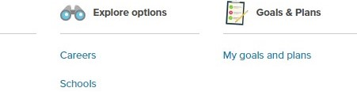
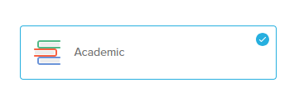



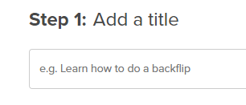
Create an Academic Goal
Step 1: Click Goals & Plans
Step 4:
Select Academic
Step 2:
Click Add Goal
Step 5: Click Next
Step 3:
Add a title to your goal, ex. Increase my GPA
Step 6: Click Set Goal

Slide 3
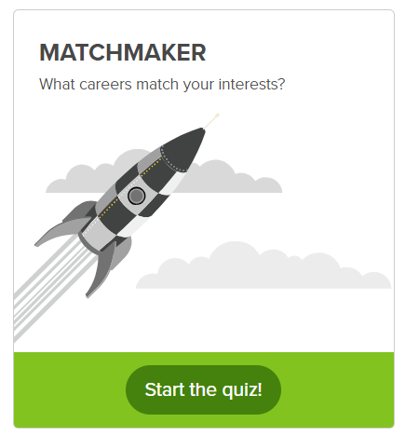

Career Matchmaker Quiz
Step 2:
Click Start the Quiz
Step 1:
Click About Me
When you have completed the Matchmaker Quiz you will see a listing of different careers that match your interest. Take time to explore these careers and save 3 career clusters.

Slide 4




Create a Career Plan
Step 1: Click Goals & Plans
Step 4:
Select Career Choice
Step 2:
Click Add Plan
Step 5: Click Next
Step 3:
Add a title to your plan, ex. become a teacher
Step 6: Click Done

Slide 5
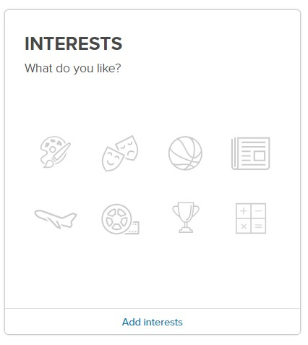
Personal Interests
Step 2:
Add Interests
Step 1:
Click About Me
Choose at least 5 Interests

Slide 6
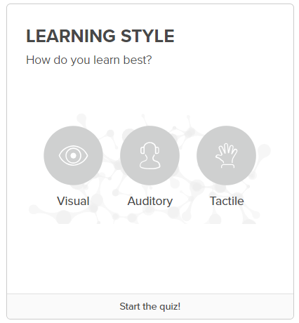
Learning Style Quiz
Step 1:
Click About Me
Step 2:
Click Start the Quiz
This quiz will give you an idea of how you learn best.
Visual ~ Auditory ~ Tactile

Slide 7
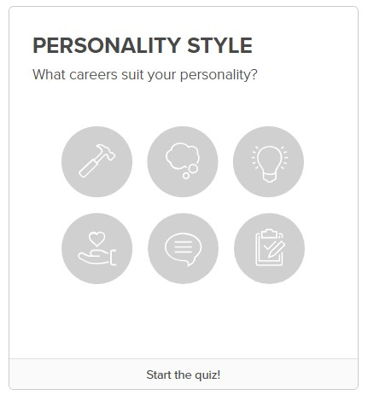
Personality Style Quiz
Step 1:
Click About Me
Step 2:
Click Start the Quiz
This quiz will give you an idea of what careers best suit you.

Slide 8

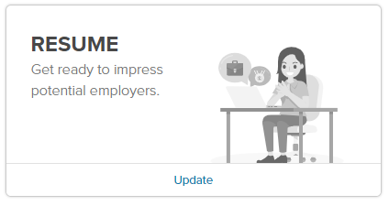
Record Experiences ~ Resume
Step 3:
Complete Each Section
Objective:
Click Add ~ Update Resume
Education:
Click Add ~ Add New ~ Update Resume
Skills:
Click Add ~ Add New ~ Update Resume
Work Experience:
Click Add ~ Add New ~ Update Resume
Volunteer Experience:
Click Add ~ Add New ~ Update Resume
Awards & Achievements:
Click Add ~ Add New ~ Update Resume
Activities & Interests:
Click Add ~ Select Saved Interests or Add New ~ Update Resume
Step 1:
Click About Me
Step 2:
Click Resume

Slide 9
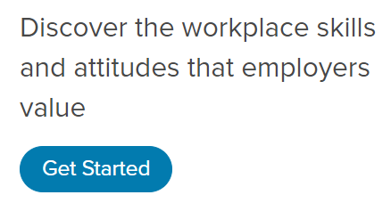

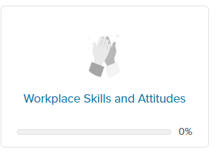
Workplace Skills and Attitudes
Step 1:
Click View all Lessons
Step 2:
Click Workplace and Attitudes
Step 3:
Click Get Started

Slide 10
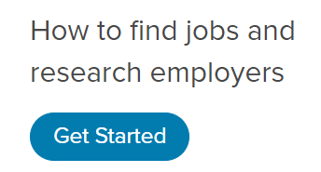
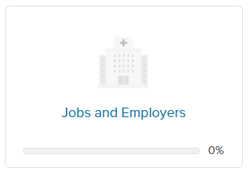
Jobs and Employers
Step 1:
Click View all Lessons
Step 2:
Click Jobs and Employers
Step 3:
Click Get Started

